Slide 1
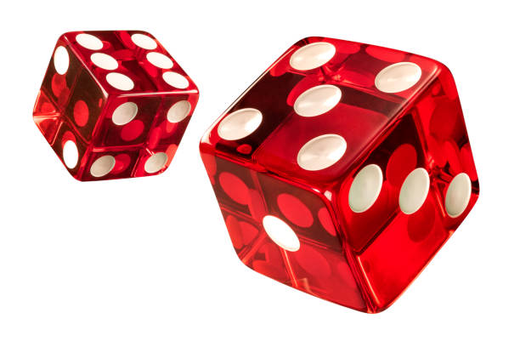
Guilt and Shame in the Context of Gambling Disorder Treatment MCPGSA – 06/19/2024
Jeremiah Weinstock, PhD
Notes:
Hello and thank you for this invitation to speak at the Focus on the Future conference! I am so thrilled to be here and share some of my knowledge and passion about working with individuals suffering from a gambling disorder. Before I begin, I want to highlight that much of my training and research is ground in a CBT conceptualization of addiction with slightly more emphasis on the B than C. And so, throughout this talk today, I will be speaking from this perspective.
I have used motivational interviewing in my clinical practice for decades. It can be an effective tool at the start of treatment, as a brief intervention, and during the course of therapy when I encounter ambivalence about change. It is an adaptable approach to working with clients.
Comment about learning environment and being nonjudgemental of others as we learn together!

Slide 2
Workshop Goals
Define guilt and shame and differentiate these negative emotional experiences as they relate to gambling disorder.
Discuss how shame is associated with stigma and may be a barrier to treatment engagement.
Identify methods to assess guilt and shame and how results of this assessment can guide gambling disorder treatment.
Notes:
This workshop assumes you have some foundational background and skills in counseling and about motivational interviewing. I will do a brief definition of MI, a short review of the research on MI as an intervention for gambling disorder to demonstrate that it is an evidenced-based practice, and finally we will work on refreshing/refining your reflective listening skills – which is fundamental aspect of conducting a good motivational interview!

Slide 3
The social context of a gambling disorder
Goodwin et al. (2017)
Gambling Disorder Criterion #7: Lies to others to conceal gambling behavior. the feelings of guilt and shame.
Notes:
An individual with a gambling disorder, while they may gamble alone or in isolation, the impact of the gambling disorder is felt by those connected to the individual. A recent study found that a gambling problem affects on average six other people in an individual’s social network (Goodwin et al., 2017). A gambling disorder affects family members (spouse, parents, grandparents, children), friends co-workers.
Lying in the context of gambling disorder frequently happens to prevent disclosure of the negative consequences. Many gamble more than they intend, gambling losses build up over time, have explain how time was spent elsewhere or why they were otherwise distracted. In fact lying is so indicative of a gambling problem, that it is built into our diagnostic criteria.
Criterion #7 – It’s almost as if they built in guilt and shame into the diagnostic criteria! Lying is a behavior that is closely associated with the feelings of guilt and shame.
The overarching point as it relates to this workshop is that guilt and shame are emotions embedded within a social context and often arise from our concerns about what others may think about us. Thus, the experience of guilt and shame is not uncommon for individuals diagnosed with a gambling disorder.
So what is guilt? What is shame? Let’s define these terms.

Slide 4
Terminology
Guilt
A feeling of remorse or regret which involves preoccupation with a particular transgression/event.
Shame (broadly defined)
A feeling/thought/belief that one is not good enough. Central to the experience of shame are feelings about one’s inadequacy and lack of worth.
Greenberg (2024); Lewis (1971); Tangney & Dearing (2002)
Notes:
Guilt arises when people ‘‘wish they had behaved differently or somehow could undo the bad deed that was done’’. Guilt involves mentally undoing some aspect of the transgression. Guilt can be transitory – coming and going.
Shame is tied to the attribution of a certain event to perceived deficiencies of one’s core self. It arises from being unacceptable in the eyes of others. In other words, shame is the internalization of others’ (perceived) disappointment, anger, or dissatisfaction. Shame is a chronic. “I’m fundamentally flawed. I am a bad person!” There is an element of fear/anticipatory anxiety where the person would be judged negatively by others.
Shame can be broken down into several distinct types that we will discuss later.
According to Hoblitzelle (1987), shame differs from guilt, in that shame is associated with stable and global internal attributions, whereas guilt is associated with specific and temporary internal attributions.
Please note that I am primarily talking about shame from a Western cultural lens. Shame differs by culture. Chinese culture has 4 different definitions of shame. Japanese culture has shame specific psychiatric disorders. For example, there is a disorder that is different that social anxiety disorder and is more about a phobia of bring shame to oneself.

Slide 5
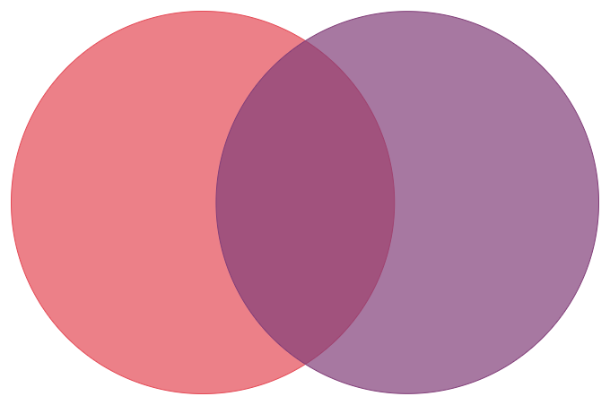
Distinction between Guilt or Shame
Guilt recognizes the action as a transgression.
“I did a bad thing.”
Shame recognizes oneself as being unacceptable in the eyes of others.
“I am a bad person.”
GUILT
SHAME
Schlagintweit et al. (2017)
Notes:
Gamblers who attribute the gambling loss to unstable, controllable aspects are likely to experience guilt. “The cards were cold tonight! I’ll have better luck next time!’
Gamblers who attribute gambling to stable, uncontrollable aspects are likely to experience shame. “I am a pathetic gambler! I’m so out of control, I just can’t stop!”
Ven diagram represents that guilt and shame are highly intertwined in real-life experience (Tangney & Salovey, 1999), and both can become habitual experiences and traits (Izard et al., 1993),
Overall, the two emotions in the Ven diagram represent a globalized tendency towards negative self-appraisal.
For example, in sample of individuals who gamble regularly a strong positive correlation between guilt and shame existed (r = 0.74; Schlagintweit et al., 2017).

Slide 6
Guilt or Shame?
Attributions about Recent Gambling
“My relapse this past week just proves once an addict, always an addict.”
“I drank too much while gambling that night. I shouldn’t have done that; I know better.”
“I am a pathetic gambler who constantly loses her money. Like my dad always said, “I’m a waste of oxygen.”
SHAME
GUILT
SHAME
Notes:
What attribution is the person making about the gambling behavior? Is it about the person or the situation?
Gamblers who attribute gambling to unstable, controllable aspects are likely to experience guilt.
Gamblers who attribute gambling to stable, uncontrollable aspects are likely to experience shame.
Shame
Guilt
Shame

Slide 7
Guilt and Shame in Relation to Gambling
Many individuals who gamble, regardless of problem gambling severity experience guilt about their gambling losses.
Yi & Kanetkar (2011)
Notes:
Yi & Kanetkar (2011) recruited 284 individuals from the community who had recently gambled at least $80 in a single episode and felt badly about it.
Classified people into three groups: (1) low-risk gamblers, (2) moderate-risk gamblers, and (3) problem gamblers. Regarding their gambling episode, they felt badly about, on average the low-risk gamblers lost $160, the moderate-risk gamblers lost $245, and the problem gamblers lost $322. They then asked them to rate their feelings about the episode in terms of guilt and shame.
Graph:
Guilt – problem gamblers and low-risk gamblers were not significantly different from each other. The moderate-risk gamblers were significantly higher.
Shame: All groups were significantly different from each other.
And this is only about one episode. The graph here might look much different with greater differences between the groups, if we asked about the totality of their gambling behavior.

Slide 8
Guilt and Shame in Relation to Gambling
Many individuals who gamble, regardless of problem gambling severity experience guilt about their gambling losses.
As gambling problem severity increases, the likelihood of experiencing shame about their gambling losses increases.
Yi & Kanetkar (2011)
Notes:
Yi & Kanetkar (2011) recruit 284 individuals from the community who had recently gambled at least $80 in a single episode and felt badly about it.
Classified people into three groups: (1) low-risk gamblers, (2) moderate-risk gamblers, and (3) problem gamblers. Regarding their gambling episode, they felt badly about, on average the low-risk gamblers lost $160, the moderate-risk gamblers lost $245, and the problem gamblers lost $322. They then asked them to rate their feelings about the episode in terms of guilt and shame.
Graph:
Guilt – problem gamblers and low-risk gamblers were not significantly different from each other. The moderate-risk gamblers were significantly higher.
Shame: All groups were significantly different from each other.
And this is only about one episode. The graph here might look much different with greater differences between the groups, if we asked about the totality of their gambling behavior.

Slide 9
Gambling and Guilt
Several studies demonstrate that the feelings of guilt do not lead to future gambling episodes. Guilt is not associated with coping motives.
Rather the experience of guilt stemming from gambling creates agency to act and resolve the feelings of guilt.
“What do I need to do to fix the situation?”
“How do I repair the damage done?”
Schlagintweit et al. (2017); Treeby & Bruno (2012); Yi & Kanetkar (2011)
Notes:
Basically, my guilt does not lead me to gamble as means to cope with it or other emotions.
Rather the experience of guilt leads to active coping and problem solving.
The urge to act and fix the situation is generally a good thing. It’s how change happens for some individuals. “I’m never going to do that again!”

Slide 10
The Experience of Shame
Shame
Emotion
Physiological
Social
Behavioral/
Motivational
Cognitive
Greenberg (2024)
Notes:
An emotional component: A bodily felt sinking feeling, shame-anxiety, self-disgust, self-contempt.
An internal self-evaluative component: I am bad, inadequate, flawed, useless, a failure.
A social component: Others see me as bad, inadequate, useless, a failure and are contemptuous of me.
A motivational/behavioral component: Desire and tendency to hide or conceal own behaviors, feelings of rage or thoughts about retaliating against shamer.
A physiological component: Increased arousal, sympathetic/para-sympathetic autonomic nervous system, stress hormone release
ADD MORE LATER FROM LATER PART OF NOTES.

Slide 11
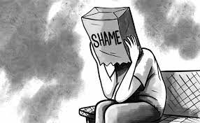
Different Types of Shame
Three Types of Shame:
Primary Adaptive Shame
Primary Maladaptive Shame
Secondary Shame
These are not mutually exclusive categories. Individuals can experience multiple types of shame at the same time.
Greenberg (2024)
Notes:
Did you know there are different types of shame?
I ask this question and you may be thinking to yourself, “Oh, here we go! We’re going down some academic rabbit hole about shame. Time to zone…” I promise we are not getting too far off into the weeds. It is not just some psychobabble.”
I promise you these distinctions are important as they guide intervention.

Slide 12
Defining Types of Shame
Three Types of Shame:
Primary Adaptive Shame
Primary Maladaptive Shame
Secondary Shame
Primary Adaptive Shame
Adaptive shame informs people that they have violated important standards or values and their social group’s norms.
Greenberg (2024)
Notes:
The experience of primary adaptive shame is what separates a typical person from someone being diagnosed with antisocial personality disorder!
Primary adaptive is also associated with feelings of being overexposed or in danger of not getting people’s support. If they found out what you did, then they would see you differently and not be as nice to you.

Slide 13
Gambling and Shame
Primary Adaptive Shame Example:
“Over the past six months, I withdrew $50,000 in my daughter’s college fund, and I lost it all gambling. I am so ashamed of myself.”
The act of gambling generates the shame for violating social norms and trust that exists in relationships.
Greenberg (2024)
Notes:
It’s a violation of morals, values, and trust in the eyes of other people.

Slide 14
Gambling and Shame
What happens next when the following occurs?
The individual with a gambling problem has been drinking heavily (potentially intoxicated).
Others discover the gambling problem and the full extent of financial harm. “The ‘great’ lie is over.”
The individual has a history of making impulsive decisions.
Access to lethal means.
Acute risk for suicide increases dramatically!

Slide 15
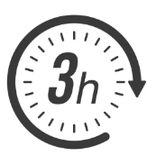
Acute Episode of Risk for Suicide
From the decision to die to a suicide attempt:
36%
44%
73%
Paashaus et al. (2021)
Notes:
118 inpatients (62.7% female; age: M = 38.71, SD = 14.71) hospitalized due to a recent suicide attempt were assessed using structured clinical interview measures assessing suicidal history.
The main aim of this study was to determine the proportion of suicide attempters, who reported a rapid transition (≤5, ≤10, ≤180 min) between their decision to die and their actual attempt.

Slide 16
Gambling and Shame
Primary Adaptive Shame Example:
Shame in this instance can also be expressed as outwardly directed anger.
“The casino knows I have a gambling problem. Yet, they are trying to be my best friend. They keep sending me offers for “risk-free bets” and other comps to get me to gambling again. It’s just criminal! I can’t believe they get away with this stuff! This is what’s wrong with America today! People can do whatever they want, even it hurts other people….. It’s all in the name of the almighty dollar!”
Greenberg (2024)
Notes:
Primary adaptive shame can also be expressed as outwardly expressed anger
Outwardly expressed anger can be protective from feeling shame in this situation.

Slide 17
Gambling and Shame
Three Types of Shame:
Primary Adaptive Shame
Primary Maladaptive Shame
Secondary Shame
Primary Maladaptive Shame
An enduring part of a person’s experience that influences their whole personality and forms the undercurrent of experience.
Greenberg (2024)
Notes:
Primary maladaptive shame is not an episodic reaction, felt in a moment, but is a more enduring part of a person’s experience that influences their whole personality and forms the undercurrent of experience without emerging explicitly into awareness

Slide 18
Gambling and Shame
Primary Maladaptive Shame
Early experiences of being ignored, invalidated, ridiculed, and rejected, as well as experiences of abuse and neglect, generally lead to the development of a core sense of self as flawed, defective, worthless, not mattering, and unlovable.
Greenberg (2024)
Notes:
Primary maladaptive shame can come from family members, but also arise from belonging to a marginalized group (e.g., race, ethnicity, gender, sexual orientation).
What if you are a member of the LGBTQ community in a politically conservative area or your family practices a religion that is not accepting of LGBTQ individuals?
URM
Stigma, if internalized by the individual, becomes primary maladaptive shame.

Slide 19
Gambling and Shame
Primary Maladaptive Shame Example:
“I gamble because when I am at the casino, I can forget everything. And if I win, I feel special!! It’s the only place where I have a chance of feeling good about myself.”
The act of gambling is about the avoidance of the feeling of shame.
Greenberg (2024)
Notes:
Primary maladaptive shame is not an episodic reaction, felt in a moment, but is a more enduring part of a person’s experience that influences their whole personality and forms the undercurrent of experience without emerging explicitly into awareness. Early experiences of being ignored, invalidated, ridiculed, and rejected, as well as experiences of abuse and neglect, generally lead to the development of a core sense of self as flawed, defective, worthless, not mattering, and unlovable
Primary maladaptive shame is painful as people constantly condemn themselves. They condemn themselves for breathing, for being alive, for being a burden on others, for not being a “better” or “good” person.
Primary maladaptive shame was the client I mentioned at the beginning of the talk. The client whose main presenting problem was shame. The individual felt shame because as a child they were identified as having an intellectual disability and placed in special education and told they would never amount to much. During the period of emerging adulthood they discovered they were gay and were scared to come out to their religious family. It was just another way the person felt different. To add more salt to the wound, the client lived in a politically conservative and somewhat rural area where LGBTQ individuals were treated differently/stigmatized. Thus, the client wanted nothing to do with the gay community. And oh, by the way, the only other recovery activity the client was willing to engage was Celebrate Recovery which also had members who were not very accepting of people from the LGBTQ community.
Can you feel the same this person experiences everyday of their life? The slot machines were the only place where they could be themselves.

Slide 20
Gambling and Shame
Three Types of Shame:
Primary Adaptive Shame
Primary Maladaptive Shame
Secondary Shame
Secondary Shame
A person’s emotional reaction to another (primary) emotion, such as when one feels ashamed of one’s sadness or anger.
Greenberg (2024); Mathews & Volberg (2013); Soto et al. (2011)
Notes:
Secondary shame is when you feel bad about having a feeling.

Slide 21
Gambling and Shame
Secondary Shame Example:
“I am so depressed and lonely. I am ashamed I am such a mess. I should have my act together! I gamble when I am lonely, I go to the casino to manage my depression. It’s a place to be social without having to be social. I am so ashamed of my depression though, I don’t know what else to do but gamble…”
The act of gambling is a coping mechanism for feelings of depression and loneliness.
Greenberg (2024)
Notes:
Secondary shame can be a barrier to seeking help.

Slide 22
Conceptualizing Gambling and Shame
Two primary relationships between gambling and shame:
The act of gambling generates shame due to violation of norms/trust.
The act of gambling alleviates (temporarily) feelings of shame.
Ask yourself, does culture play a role in the client’s experience of shame?
Greenberg (2024)
Notes:
As clinicians, how do we intervene with these two different types of shame? Is the same approach used for both? What if culture is an important facet of how an individual experiences shame?
Are there contexts in which this type of shame is more likely to occur? Does one’s culture influence how common this type of shame might be?
Asian identities are forged by trying to avoid any shame-producing feelings. Asian cultures, which is not monolithic/uniform, generally view the “self” much differently than in the Western culture/society. In Asian cultures, identity is centered more on the collective “we” of the family or some other social unit (Mattews & Volberg, 2013).
I shouldn’t be feeling down today because I have some much to be thankful for. I have a great family.
Secondary shame interrupts fully experiencing one’s emotions. In a Western cultural context, that is how we process our emotions and experience. It can be distressing and harmful to mental health. In an Eastern cultural context, the shame is not as harmful or damaging. There’s a great study that illustrates this point:
Emotional Expression: Soto and colleagues (2011) conducted a study that examined the relationship between the presence of emotional suppression (conscious inhibition of one’s own emotionally expressive behavior while emotionally aroused) and mental health.
In the first group, they found that greater emotional suppression was associated poorer mental health (as assessed by CES-D and Satisfaction with Life Scale). This is typical of what we would expect in relation to American culture.
The second group, they found no relationship between emotional suppression and mental health. Those who were high on emotional suppression were no different than those who were low on emotional suppression in terms of mental health. The second group were individuals from Hong Kong, China.
Why does emotional suppression have no relation to mental health in this sample? ANSWER: Cultural norms. In cultures in which use of suppression is more normative (e.g., Hong Kong Chinese), the tendency to suppress emotions is not associated with adverse psychological functioning, as it is among cultures in which expressiveness is the norm (e.g., USA).
But we live in a Western society and individuals from Asian backgrounds have differing degrees of acculturation.
Soto, J. A., Perez, C. R., Kim, Y. H., Lee, E. A., & Minnick, M. R. (2011). Is expressive suppression always associated with poorer psychological functioning? A cross-cultural comparison between European Americans and Hong Kong Chinese. Emotion, 11(6), 1450.

Slide 23
Treatment Approaches for Guilt and Shame
Assess to identify and label the client’s feelings.
Guilt?
Shame masked as outward anger?
Shame? – What type of shame?
Greenberg (2024)
Notes:
How do we assess, especially since the client is potentially fearful of judgment?

Slide 24
Treatment Approaches for Guilt and Shame
Norming the experience and providing psychoeducation
“Many individuals with gambling disorder experience these feelings. You are not the first nor unfortunately the last to experience this.”
Greenberg (2024)
Notes:
How do we assess, especially since the client is potentially fearful of judgment?

Slide 25
Treatment Approaches for Guilt and Primary Adaptive Shame
The experience of guilt generates agency for corrective action.
Problem-solve on potential correction actions.
Pros and cons of each potential action?
Which is one(s) are more appropriate/realistic?
Are multiple actions required?
Support the client’s action.
Co-engagement with affected others.
Co-construct an understanding of what happened, what it means for their relationship, and a way forward (if both parties so desire)
Greenberg (2024); Woodyatt et al. (2022)
Notes:
Gamblers Anonymous would call this “making amends” – Steps 8 & 9.
Point 3: Gamblers who commit a transgression results in the loss of their acceptance as good and appropriate group members or relationship partners and sharing the values underpinning that bond. Thus, interpersonal transgressions indicate a loss of shared identity — the foundations of the relationship between ‘us.’
Point 3: The showing of shame to others is restorative in a social context. It’s the beginning of reconciliation. The expression of shame to others is a significant ingredient in rebuilding trust and promoting forgiveness. The offender acknowledges the injustice of their behavior to the other person by expressing their shame.
Co-engagement involves the victim and offender co-engaging with one another, reciprocally responding to the other's psychological needs, and co-constructing a shared understanding of what has occurred, their relationship, and a way forward. Each of these steps represents periods of vulnerability where the losses of a transgression can be repaired - or exacerbated.

Slide 26
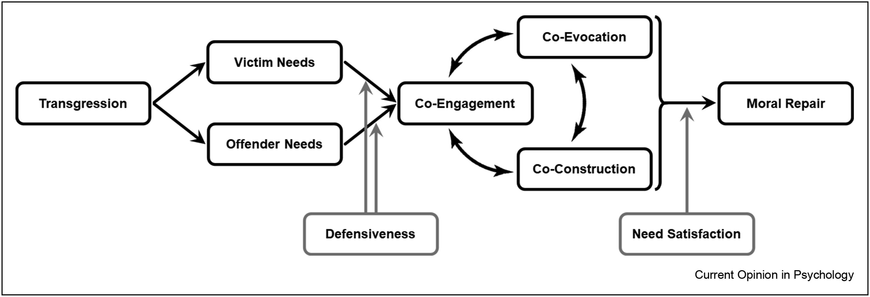
Treatment Approach for Primary Adaptive Shame
Woodyatt et al., 2022
Notes:
First, moral repair can be threatened by self-protection in the face of loss, particularly in relation to acute agency threats. It can prevent individuals from being open to engage constructively in moral repair.
Second, offenders and victims tend to differ in their perspective, memory, or recall of transgression accounts, and thus often approach the reconciliation process with disparate views on what was lost in the transgression and what is required for moral repair, Do they agree on what happened?
Third, it is not just the events but the meaning of the events and the shared understanding of the values underpinning their relationship that need to be co-constructed

Slide 27
Treatment Approach for Primary Maladaptive Shame
Transformation comes from close contact with new emotional experiences derived from content generating the feeling of shame.
Therapist’s task is to facilitate a new emotional experience:
A client must first feel shame in order to change it.
What is shame’s source? Review the narrative in client’s head.
Activate other emotions in relation to the source: sadness, compassion, anger.
Anger requires action.
Cognitive restructuring of how past events are understood/interpreted to generate new/different emotions.
Greenberg (2024)
Notes:
Point 1: A person has to arrive a place before they can leave it. Many have been avoiding feeling shame. Clients have to be prepared to endure looking at the sun; it may be painful.
Point 2: To accept one shame is not enough! Leaves you feeling ashamed or angry at yourself. More work is required.
Point 3: Client needs to understand where the shame comes from. What is it’s source? The therapist then helps the client activate other emotions, primarily anger, sadness, compassion.
Point 3: What is the narrative of the client’s experience around events that generate shame. How can we modify this narrative infusing compassion, sadness, and anger? Look for opportunities to validate the client’s experience that were outside their control, where they had limited agency to change the situation, or were impaired in some fashion that alternative, more adaptive decisions were not possible (i.e., gambling in response to primary maladaptive shame).
The shame then melds into something else. A new emotional experience/reaction that create action of moving forward rather than withdrawal and avoidance that commonly occurs in the presence of shame.

Slide 28
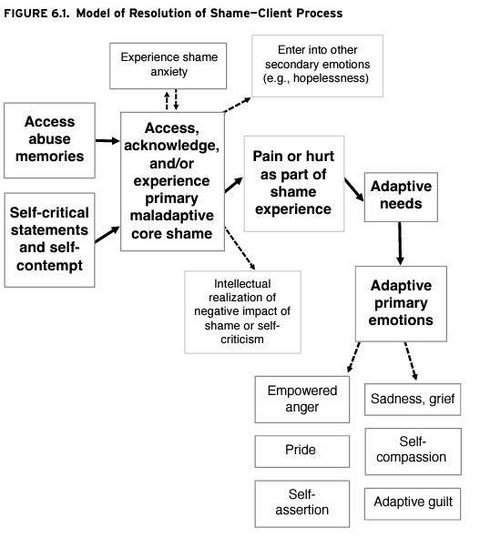
Treatment Approach for Primary Maladaptive Shame
Greenberg (2024)
Notes:
Treatment involves accessing feelings of shame, then developing self-capacity to assert against that self-criticism to develop compassion for the self, rather than contempt.
Shift overgeneralizations
Shame → Guilt → Self-Understanding and Compassion

Slide 29
Thank you!
Jeremiah Weinstock, PhD
Professor of Psychology
Saint Louis University
Jeremiah.weinstock@health.slu.edu

