Slide 1
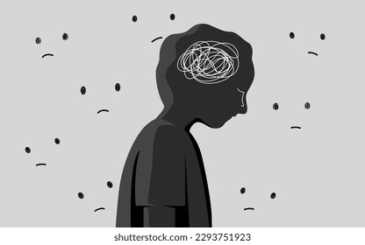
Sometimes, We Aren’t so Nice to Clients
Stigmatization of Clients by Staff

Slide 2
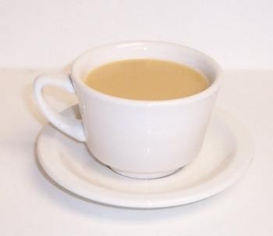
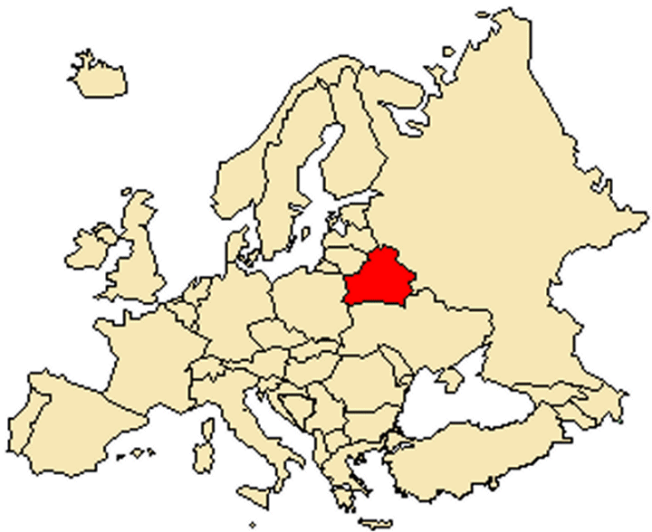
Hello!
Dana C. Branson, PhD, LCSW
Southeast Missouri State University, Department of Criminal Justice, Social Work, & Sociology
573-651-2541
dbranson@semo.edu
Notes:
Certified Clinical Trauma Professional (CCTP)

Slide 3
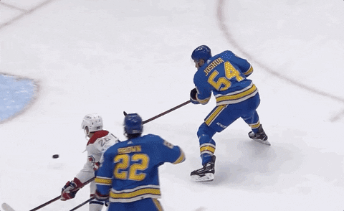
Workshop Goals
1. Evaluate research that indicates clients often feel negatively judged by treatment staff, which serves as a deterrent to recovery efforts.
2. Examine the unique reasons treatment staff may engage in non-productive judgmental behaviors, specifically unchecked implicit and explicit bias.
3. Assess implications of research findings to staff and agencies, the need for a non-judgmental approach to client care, and ideas for interventions beyond in-service trainings

Slide 4
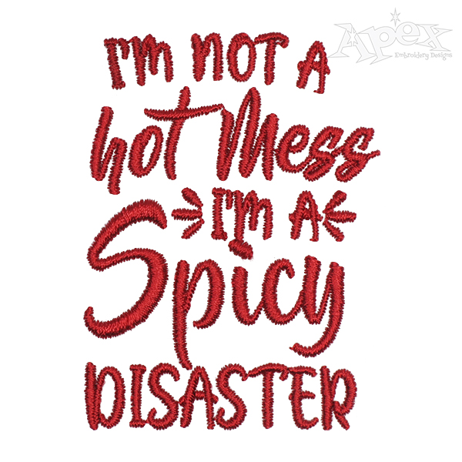
It’s complicated!
Substance abuse disorders (SUD) are highly complex
Mental health issues are highly complex
Manifestations of trauma are highly complex
Commonality for our clients to be struggling with all 3 phenomena co-morbidly
75% of those seeking SUDs treatment report a history of trauma (McMahon, 2018)
> 90% of those seeking mental health services struggle with unresolved trauma (NCBH, 2020)
45-64% of incarcerated pop struggle with mental health (Collier, 2014)
62-100% of incarcerated pop report history of trauma (Thomas, 2019)

Slide 5
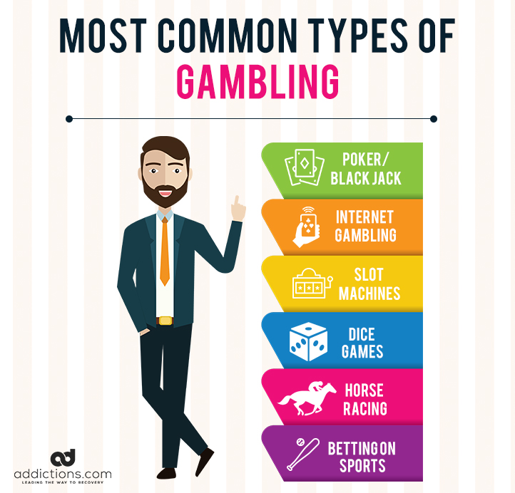
Gambling Disorder (GD) adds another layer
Oh…there is more!
Most who struggle with GD have experienced trauma of some sort (child, teen, &/or adult)
Coping technique????
Can help with numbness or to numb/escape pain (Horak et al., 2021)
95% of people struggling with GD also meet criterial for:
SUDs
Mental health issues (mood & anxiety disorders; South Pacific Private, 2021)
GD is a poorly understood phenomenon that contributes to denial, lack of seeking help, and negative clinical outcomes (Shah et al., 2020)
Only about 20% of people with GD seek treatment, and 70% of those return to gambling activities (Sohn, 2023)

Slide 6
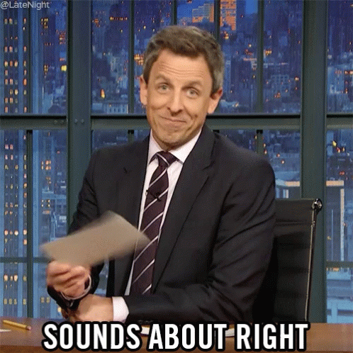
Continued…
Rarely do clients present for services with just 1 issue
Seth, age 24
Needs residential SUDS treatment
Opioid Use Disorder (304.00; F11.20)
Major Depression (296.32; F33.1)
Anxiety Disorder (300.02; F41.1)
Struggles with GD
Hx of child maltreatment
Children in Child Protective Services
10th grade education
Unemployed
Untreated STI
Lacks positive family or community supports
Parole for possession

Slide 7
SUD
Substance Use Disorders (SUD):
When the recurrent use of alcohol and/or drugs causes clinically significant impairment, including health problems, disability, and failure to meet major responsibilities at work, school, or home (SAMHSA, 2020)

Slide 8
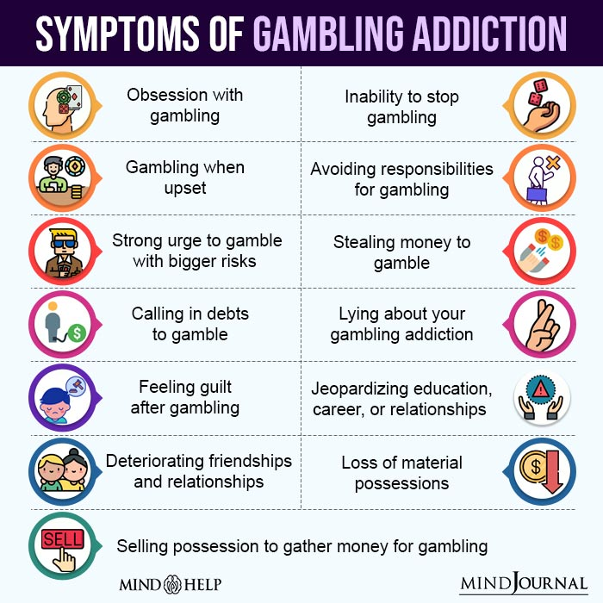
Gambling Disorder (GD)
Persistent and recurrent problematic gambling behavior leading to clinically significant impairment or distress
Often preoccupied with gambling
Persistent thoughts of past experiences
Handicapping or planning next venture
How to get money to gamble
Needs increasing amounts of money to achieve desired excitement
Unsuccessful attempts to cut back
Often gambles with feeling distressed emotionally
Chases losses
Conceals activities, creating problems with relationships and/or employment
Money often must come from others (APA, 2022)

Slide 9
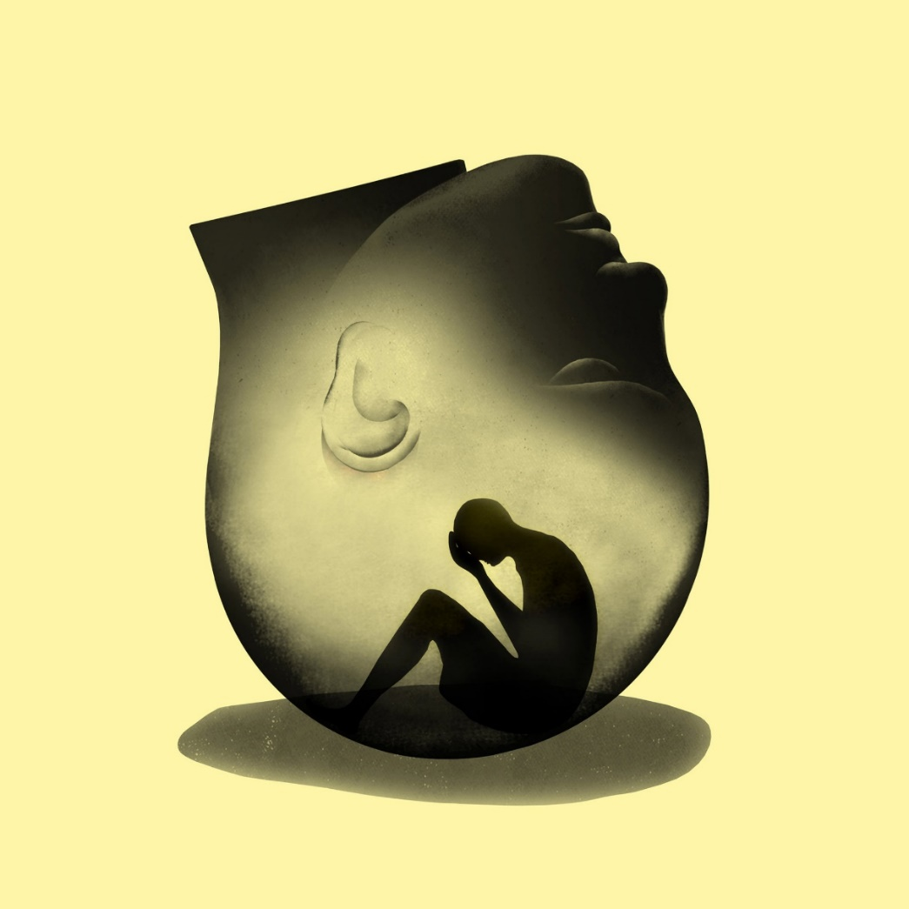
Mental health
Mental health: creates changes in thinking, mood, and/or behaviors that can affect how one relates to others and makes choices (SAMHSA, 2020). Can cause:
Over medicated
Haven’t taken medications in months
Feel unstable
Mood swings
Depressed
Manic
Suicidal/homicidal
Conspiracy theories
Psychosis (Weiten, 2021)

Slide 10
Trx is SCARY!
Excited
Ready for this
Sick & tired of being sick & tired
Angry
This is not my idea
Way worse people out there and I’m in here
Huge injustice
Cognitively
Mind fog
Flight of ideas/Can’t focus
One more chance & I can fix all this
Anxious
What is treatment going to be like
Staff and other clients nice or mean
I have no control (Levinthal & Brusman-Lovins, 2020)
Think of all the issues & emotions clients go through when coming into treatment:
Fear
Am I going to get sick
What’s life like without drugs or gambling
What will happen with my family while I’m gone
What will happen with my partner while I’m gone
Physically
Still under the influence
Hungover
Starting to feel withdrawal coming on
Feel like I want to come out of my own skin
Tired & hungry
Pain or no pain (numb)../which gambling helped

Slide 11
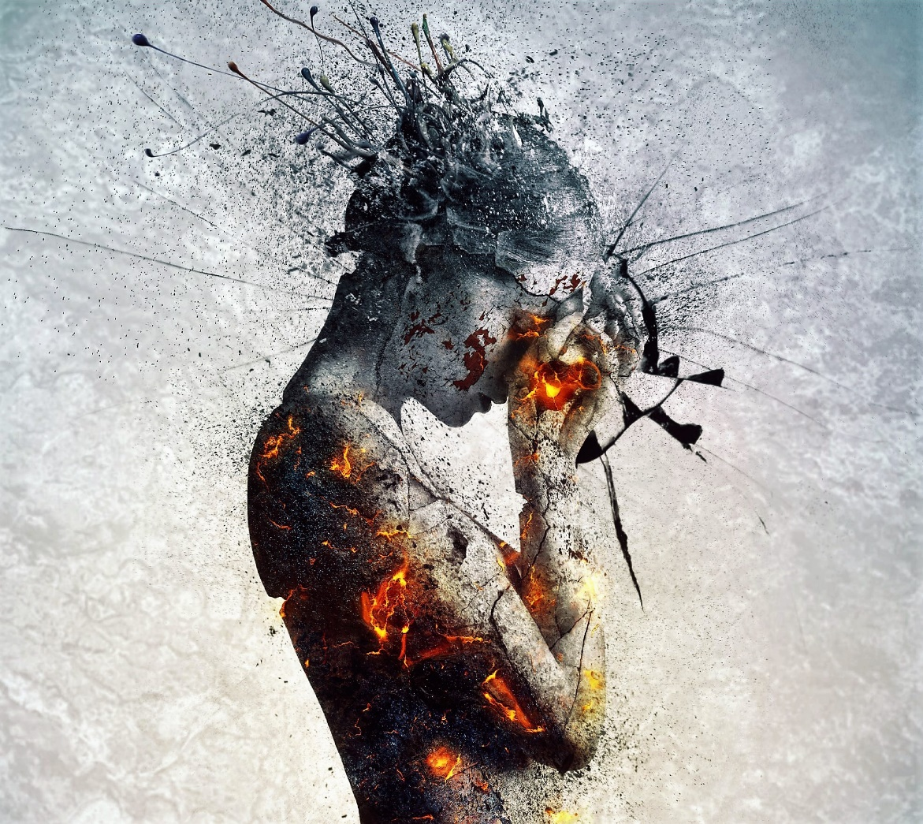
Trauma
An event, series of events, or set of circumstances that is experienced by an individual as physically or emotionally harmful or threatening and that has lasting adverse effects on the individual’s functioning and physical, social, emotional, or spiritual well-being (SAMHSA, 2022)
Trauma is the emotional, psychological and physiological residue left over from heightened stress that accompanies experience of threat, violence and life changing events (Australian Childhood Foundation, 2010)
Notes:
Will find that although the information presented today is mostly for you, there is a great deal of concepts and dynamics that will cross over into your practice with clients.

Slide 12
Trauma continued…
Fawn
Lip service and pleases everyone
Cognitive errors
Self-blame
Pathological guilt and shame
Feeling unworthy of services
Isolates
Avoids seeking help (Zare et al., 2018)
Unresolved trauma issues common at intake:
Safety concerns
Fear of unknowns
Fight
Verbally assaultive
Get my bluff in upfront-no one will mess with me
Flight
Leaves treatment after 12 hours
Disassociates
Freeze
Silence
Lack involvement

Slide 13
Immediate & Delayed Reactions to Trauma (SAMHSA, 2022)
Im Emx | Del Emx | Im Phy | Del Phy | Im Cog | Del Cog | Im Bx | Del Bx
Numbness | Irritability | Nausea | Sleep issues | Concentration | Intrusive imagery | Startle reaction | Avoidance
Detachment | Hostile | Gastro distress | Somatization | Rumination | Flashbacks | Restlessness | Activity level
Anxiety/Fear | Depression | Sweating | Appetite | Racing thoughts | Reactivation | Sleep | High risk bx
Guilt/Shame | Mood swings | Shivering | Digestive issues | Distorted time | Self-blame | appetite | D & A addiction
Anger | Phobias | Faintness | Cold/illness | Memory | Indecisive | Argumentative | Withdrawal
Sadness | Fragility | Muscle tremors | Hyperarousal | Distorted space | Magical thinking | D & A use | Criminal Bx
Feeling out of control | Poor emotional regulation | Elevated heart rate | Persistent fatigue | Identification with victims | Preoccupation with event | Difficulty expressing self | Poor school/work performance
Denial | Instability | Increased BP | Autoimmune | Self-blame | Triggers | Withdrawal | social life
Constriction | Vulnerability | Fatigue | L-T health | Neg worldview | Dangerous world | Apathy | Fighting
Disorientation | Survivor guilt | Startle response | Elevated Cortisol | Losing reality | worthlessness | Avoidant Bx | Paradoxical Bx
Overwhelmed | Mental health | Depersonalization | COPD/heart disease | Loss of self-efficacy | Suicidal ideation | Easily angered | Sexual bx
Notes:
Im = Immediate, Del = Delayed

Slide 14
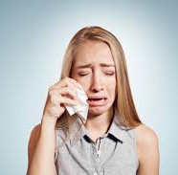
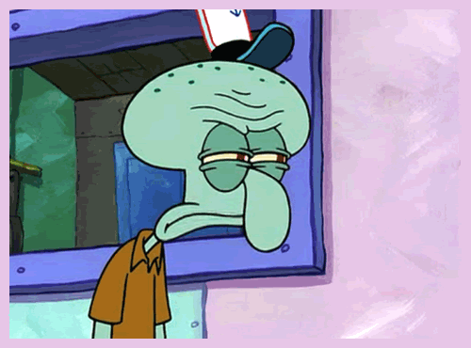
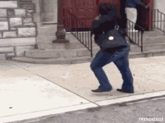
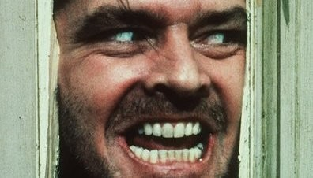
Put together in a bowl and stir…..

Slide 15
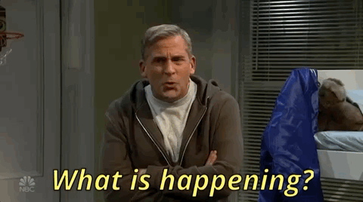
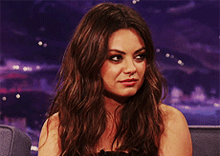
Just Behave!!!!
Clients’ behaviors & acting out often cause them to be negatively judged by staff:
Manipulative
Resistive to treatment
Lazy
Troublemaker
Attention seeking
Liar
Poor moral values
Disrespectful (Milburn et al., 2019)

Slide 16
We Should not be Surprised!

Slide 17
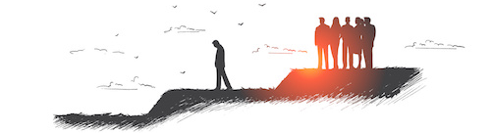
Research indicates….
Clients commonly feel stigmatized by treatment staff & social service agencies (Branson et al., 2023; Brown, 2018; McCallum et al., 2015; Owens et al., 2020)
Stigma: a disapproving attitude due to a characteristic that becomes the lens through which society views the person (Gritter & Walsh, 2020).
Self-stigma: an individual begins to view themselves through the lens that society applies to them (Mackenzie et al., 2019).

Slide 18
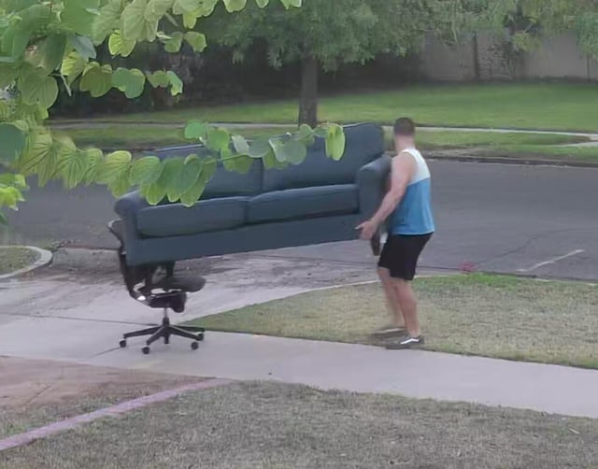
Research Indicates continued…
Client who feel stigmatized by staff:
Less likely to seek help for needed services
Mental health
Medical
SUDS
Police protection (Owens, et al., 2020)
IV drug users would rather share or pay to use someone’s needles than purchase new needles (Dengo-Baloi et al., 2020)
Clients are more likely to continue in negative behaviors (Kelly & Ward, 2018)
Key factor why clients leave treatment prematurely (Jalali et al., 2019)

Slide 19
Here’s the Good News—The Opposite is Also True!!!
Clients who felt valued regardless of their drug history or behaviors and their self-determination was honored were more likely to stay in treatment and complete successfully (Branson et al., 2023; Johnson et al., 2019).
Treatment staff who are in recovery & are open to sharing their journey are:
Encouraging
Motivating
Increase in desire to stay in program (Cos et al., 2020)
Clients commonly report relatability to peer staff, citing a significant increase in feeling:
Understood
Accepted, regardless of their behaviors
Open to staff recommendations
Hearing statements of accountability from peer staff (Fallin-Bennett et al., 2020).

Slide 20
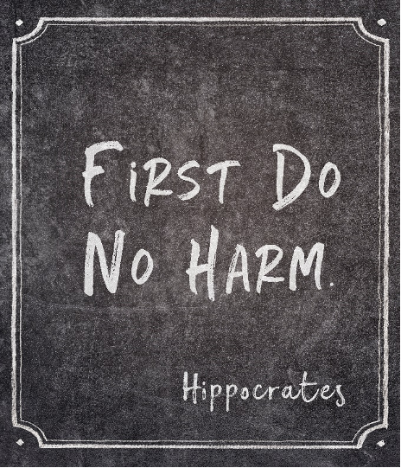
Lots of Ways to be Judgy!
Covert
Clients are MASTERS are reading people—it is a survival skill developed over time
Overt
Purposefully humiliating clients
Verbal
Purposeful hurtful statement
Insensitive statements
Statements of ignorance
Non-verbal
A look can say a thousand words
Institutional
Program rules that make clients feel unwelcomed

Slide 21
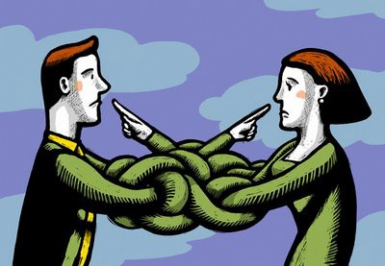
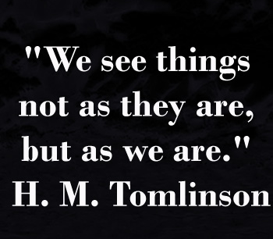
Wait a minute…
Additional commonalities that go with SUDS, MH, & Trauma:
Guilt
Shame
Self-stigmatization
Overdeveloped vigilance for judgement
Projection: taking unacceptable qualities and feelings about oneself and attributing them to others
Sometimes staff do everything right…but clients still feel judged due to their own internal struggles

Slide 22
Actively listening to the Experts
Approval from IRB before data collection started
Informed consent/ Debriefing sheet
Quantitative survey
ACE Survey
Questions pertaining to trauma experienced
Qualitative data
Focus group
n = 47
Males, females, & non-binary
Before & during COVID-19
Notes:
1. What treatment interventions have been most helpful to you with your experiences of trauma?
2. What treatment interventions have been unhelpful to you with your experiences of trauma?
3. What characteristics of counselors, therapists, or peer specialists have been most helpful in working on your experiences with trauma?
4. What characteristics of counselors, therapists, or peer specialists have been unhelpful in working on your experiences with trauma?

Slide 23
Statistical analysis
Adult Traumas: a scale of 16 items describing trauma occurring after age 18
Intimate partner abuse
Sexual assault
Death of loved one
Military induced trauma
Ending of significant intimate relationship
Natural trauma
Housefire
Miscarriage &/or abortion
Witness of terrifying event
Political trauma or terrorism
Other
Adverse Childhood Experiences (ACE):
Physical abuse
Emotional abuse
Sexual abuse
Physical Neglect
Emotional Neglect
Witness to dom abuse (especially mom*)
Parents divorce, separated, or died
Substance use disorder
Mental health disorder
Incarceration

Slide 24
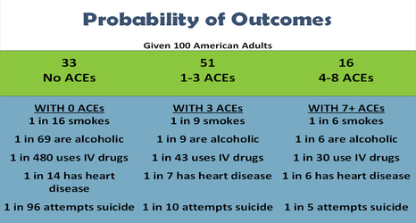
ACE: Adverse Childhood Experiences
Long-term study started in 1995
Followed cohort to study the effects childhood aversive events on adult health outcomes
SHOCKING results!!!!!!!
Over 17,000 subjects
70% Caucasian
70% College educated
21% Sexual abuse
19% Grew up with mental health issues
28% Physical abuse
64% Surveyed endorsed at least 1 ACE (Felitti et al., 1998)

Slide 25
Statistical Analysis
ACE Categories | Yes
Psychological abuse | 70.7%
Physical abuse | 51.2%
Sexual abuse | 53.7%
Emotional neglect | 63.4%
Physical neglect | 31.7%
Divorce/Death | 73.2%
Witness to abuse | 48.8%
Family mem with SUD | 80.5%
Family mem with MH | 53.7%
Family mem incarcerated | 34.1%
n= 47
Quantitative Analysis
ACE score
Additional traumas as adults
Of all participants, only 6 reported ACE score of 0
87.2% reported at least 1 ACE
Majority (28 or 59.6%) had an ACE score of 4 or higher
All females reported abuse both as a child & an adult

Slide 26
The majority of people surveyed reported seven (7) traumatic experiences during their childhoods

Slide 27
Qualitative themes
Judgement from staff—professional people. Way people come off, like you’re trash or something…and I am talking about professional people—trained, went to school and stuff. They should know better.
People judging from the moment you walk in…yeah, I looked like hell when I came in this place and maybe I had a shit attitude, but that is why I’m here…I need help, not your fucking judgement.
People who have never been through it judging me—you don’t know what you don’t know.
Being judged—like I’m some kind of low life because bad things happened to me. Yeah—sometimes it was because of my drug use, but most of it was when I was a kid and I didn’t have any control over it…so I really don’t appreciate people who don’t understands that.
Judgment from staff—it’s real!
All quotes from study participants

Slide 28
Here is the GOOD news (also participant quotes):
Staff who really care—you can tell because they do anything they can for you and they don’t judge you.
Caring counselors and treatment techs. They will talk you out of leaving treatment. They work their butts off and they are funny. The go above and beyond because they care for us.
Peer support staff that been there and done that…they get it. They give me hope. I used to party with some of them. Seeing them tells me I can do it too.

Slide 29
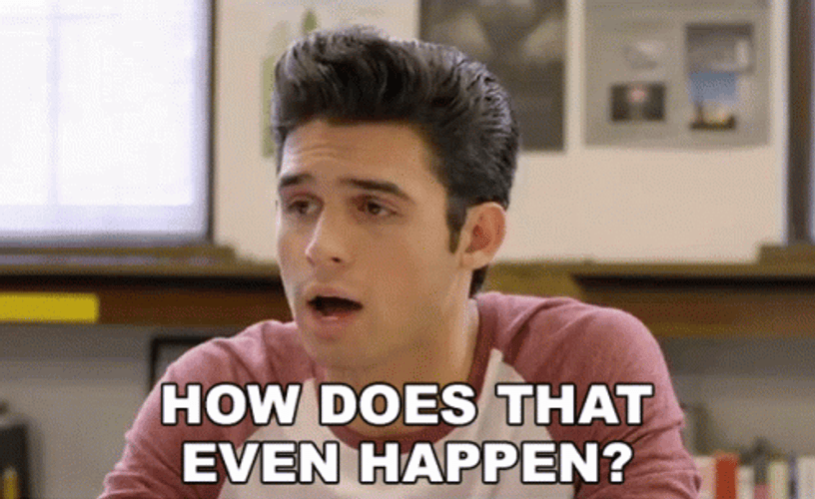
Why Does this Happen

Slide 30
What about the STAFF?????
SUDS staff and Para-Professionals:
Gregarious
Empathetic
Nonjudgmental
Hypersensitive to injustice
Self-sacrificing
Hard working
Come in early & leave late
The very characteristics that make staff AMAZING at their jobs create the avenue for occupational hazards. Additionally, we all have some stuff…

Slide 31
Cake or Pie?

Slide 32
Bais—we all have them
Implicit Bias (aka unconscious bias):
Unsupported assumptions, stereotypes, and/or judgments about people or groups that are unknowingly assigned based on a variety of factors, shaped by survival instincts that causes humans to associate with people they deem safe because they are perceived as similar
Explicit bias (aka known bias):
Individuals are aware of their prejudices and attitudes towards certain people (Chafota, 2020)

Slide 33
Claim Them, Monitor Self, & Work With Them

Slide 34
Real threats to staff
Burnout: a process influenced by
lack of administrative support
low financial compensation
high staff turnover
frequent staff shortage
difficult clients
resulting in emotional exhaustion, the development of a negative outlook on clients and the therapeutic process, reduction of productivity, and a feeling of depersonalization (Hricova & Lovasova, 2018)

Slide 35
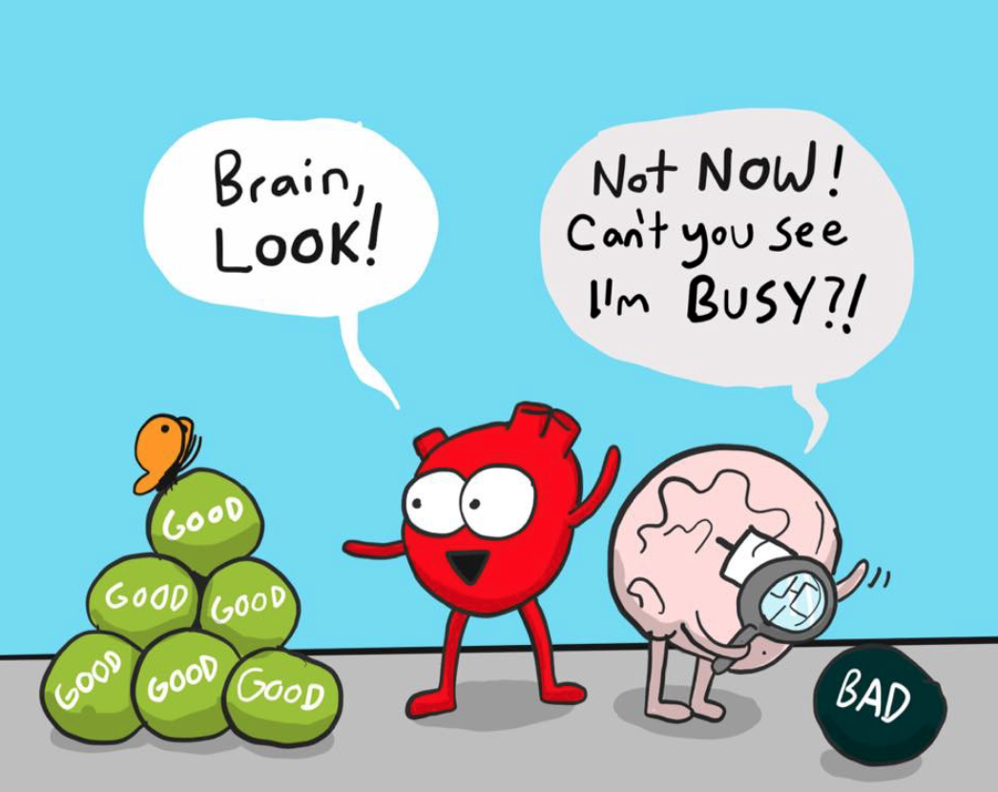
Other Couple of Biggies!
Secondary Traumatic Stress (STS): being overwhelmed by the needs of clients & the lack of resources to adequately address the issue (Hricova & Lovasova, 2018)
Vicarious trauma (VT): negative changes to one’s worldview due to an accumulation of client self-disclosures (Quitangon, 2019)…both can result in:
Emotional exhaustion
Cynicism
Negative behaviors towards clients
Pessimistic outlook
Reduction in productivity
Increased absenteeism
Good news—some of the same things suggested to help clients (rest—self care) also help with BO, STS & VT (Branson et al., 2023)

Slide 36
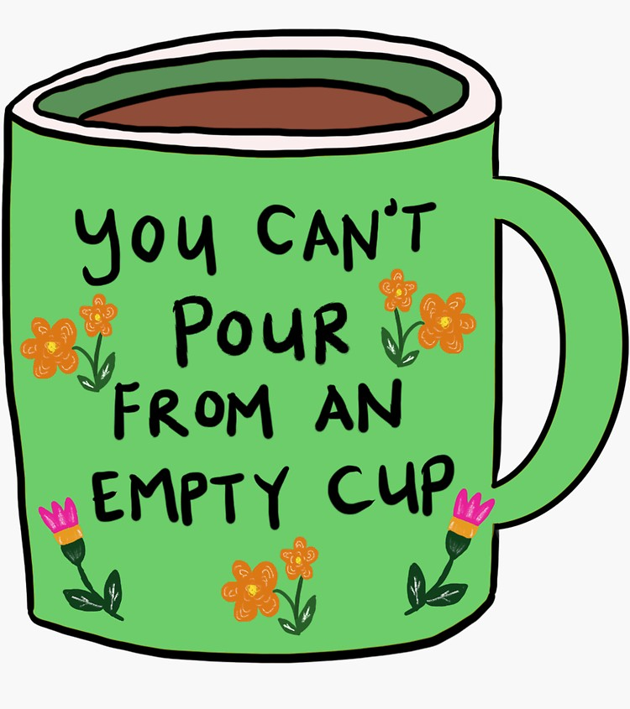
Here is the problem
Staff KNOW that self-care is important
Staff KNOW the benefits of self-care
However, as a group, we STINK at actually engaging in self-care
Counterintuitive to our desire to help others
Feels selfish, as we are self-less people
Most of us are Labradors, Gold/Blue people
Loyal to a fault
Responsible
Seek harmony
Empathic
Appreciative of others (and desire this from others)
When struggling, we tend to dig in, work even harder to get ahead of it….then we will relax (Branson et al., 2023)

Slide 37
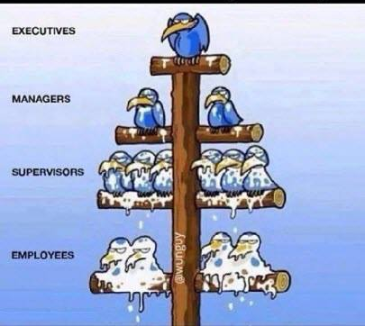
Oh…there’s more
Provide staff that are knocking it out of the park with meaningful appreciation
Needs to be a top-down flow
Administration to frontline staff
Often times, we treat staff in ways that we would NEVER treat a client…Hmmmmm
Goodness runs downhill…so does other stuff!
Maybe we all need some encouragement

Slide 38
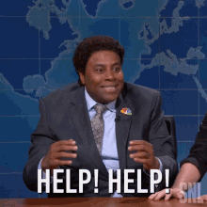
So, What Does All of this Mean??
Staff desire training and learning new skills so they are empowered to better help clients (Brown, 2018)
Some staff are knocking it out of the park—providing excellent care…Some staff are not
Increased training for all staff concerning the complexity of
SUD
Mental health
Trauma
Compacted by co-morbidity (Jalali et al., 2019)
Training boosters
Not a “one & done” check mark (Romero et al., 2017)
Cross training in a variety of modalities (Dekkers et al., 2020)

Slide 39
Good Work Should be Rewarded
Staff encourage each other
Our jobs are VERY DIFFICULT—must support each other!!
Supporting self-care
Even when short staffed!
Staff who display the type of behaviors desired towards clients should be acknowledged
Most helping professionals desire validation for a job well done
Incentives need to be meaningful
Dedication to these efforts by administration
Staff who are struggling…
Supervision, but not as a punishment
Additional trainings, if needed
Investigate the why
Too close to home
Values that are counterproductive
Biases coming out
BO, VT, and/or STS?

Slide 40
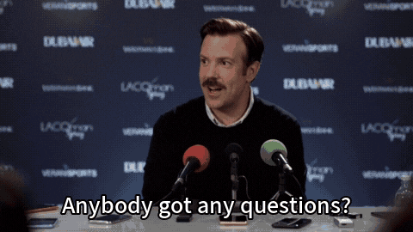
Questions????????

Slide 41
References
American Psychiatric Association. (2022). Diagnostic and statistical manual of mental disorders (5th ed., text rev.). https://doi.org/10.1176/appi.books.9780890425787
Branson, D. C. Arlington, E., & Bradley, C. S. (2023). The importance of rest in trauma services: Perhaps we should consider naps. Rehabilitation Counseling Bulletin, 41(3), 278-295. http://doi.org/10.1080/07347324.2023.2204818
Brown, V. B. (2018). Through a trauma lens: Transforming health and behavioral health systems. Routledge.
Collier, L. (2014, October). Incarceration nation. Monitor on Psychology: American Psychological Association. https://www.apa.org/monitor/2014/10/incarceration
Cos, T. A., LaPollo, A. B., Aussendorf, M., Williams, J. M., Malayter, K., & Festinger, D. S. (2020). Do peer recovery specialists improve outcomes for individuals with substance use disorder in an integrative primary care setting? A program evaluation. Journal of Clinical Psychology in Medical Settings, 27(4), 704–715. https://doi.org/10.1007/s10880-019-09661-z
Dekkers, A., Vos, S., & Vanderplasschen, W. (2020). “Personal recovery depends on NA unity”: An exploratory study on recovery-supportive elements in Narcotics Anonymous Flanders. Substance Abuse Treatment, Prevention & Policy, 15(1), 1–10. https://doi.org/10.1186/s13011-020-00296-0
Dengo-Baloi, L., Boothe, M., Semá Baltazar, C., Sathane, I., Langa, D. C., Condula, M., Ricardo, H., Inguane, C., Teodoro, E., Gouveia, L., Raymond, H. F., & Horth, R. (2020). Access to and use of health and social services among people who inject drugs in two urban areas of Mozambique, 2014: Qualitative results from a formative assessment. BMC Public Health, 20(1), 1–9. https://doi.org/10.1186/s12889-020-09068-8

Slide 42
Continued…
Fallin-Bennett, A., Elswick, A., & Ashford, K. (2020). Peer support specialists and perinatal opioid use disorder: Someone that’s been there, lived it, seen it. Addictive Behaviors, 102, N.PAG. https://doi.org/10.1016/j.addbeh.2019.106204
Felitti, V. J., Anda, R. F., Nordenberg, D., Williamson, D. F., Spitz, A. M., Edwards, V., Koss, M. P., Marks, J.S. (1998). Relationship of childhood abuse and household dysfunction to many of the leading causes of death in adults: The Adverse Childhood Experience (ACE) study. American Journal of Preventive Medicine, 14(4), 245-258. http://doi.org/10.1016-s0749-379(98)00017-8
Grittner, A. L., & Walsh, C. A. (2020). The role of social stigma in the lives of female-identified sex workers: A scoping review. Sexuality & Culture, 24(5), 1653–1682. https://doi.org/10.1007/s12119-020-09707-7
Horak, N. S., Eagle, G., Stein, D. J., & Lochner, C. (2021). Gambling Disorder and Childhood Trauma: A Complex Association. Journal of gambling studies, 37(2), 515–528. https://doi.org/10.1007/s10899-020-09983-w
Hricova, M., & Lovasova, S. (2018). Stress, secondary trauma and burnout: Risk characteristics in helping professions. Ad Alta: Journal of Interdisciplinary Research, 8(2), 161–165.
Jalali, R., Moradi, A., Dehghan, F., Merzai, S., & Alikhani, M. (2019). The exploration of factors related to treatment retention in Narcotics Anonymous members: A qualitative study. Substance Abuse Treatment, Prevention & Policy, 14(1), N.PAG. https://doi.org/10.1186/s13011-019-0205-6
Johnson, F., Hewitt-Taylor, J., & Norton, E. (2019). Lived experiences of young pregnant women who smoke. British Journal of Midwifery, 27(7), 427–433. https://doi.org/10.12968/bjom.2019.27.7.427

Slide 43
Continued…
Kelly, J. F., & Ward, C. L. (2018). Women who drank while pregnant: The importance of social context in the lives of South African pregnant women. Drugs: Education, Prevention & Policy, 25(5), 438–445. https://doi.org/10.1080/09687637.2017.1316703
Levinthal, C. F. & Brusman-Loving, L. (2020). Drugs, society, and criminal justice. Pearson
Mackenzie, C. S., Heath, P. J., Vogel, D. L., & Chekay, R. (2019). Age differences in public stigma, self‐stigma, and attitudes toward seeking help: A moderated mediation model. Journal of Clinical Psychology, 75(12), 2259–2272. https://doi.org/10.1002/jclp.22845
McCallum, S. L., Mikocka, W. A. A., Gaughwin, M. D., Andrews, J. M., & Turnbull, D. A. (2015). “I’m a sick person, not a bad person”: Patient experiences of treatments for alcohol use disorders. Health Expectations, 19(4), 828–841. https://doi.org/10.1111/hex.12379
McMahon, D. (2018, December 17). When trauma slips into addiction. The Imprint. https://imprintnews.org/child-trauma-2/when-trauma-slips-into-addiction/
Milburn, N. G., Stein, J. A., Lopez, S. A., Hilberg, A. M., Veprinsky, A., Arnold, E. M., … Comulada, W. S. (2019). Trauma, family factors and the mental health of homeless adolescents. Journal of Child & Adolescent Trauma, 12(1), 37–47. doi:10.1007/s40653-017-0157-9
National Council for Behavioral Health (2020). Trauma-informed, resilience-oriented care. https://www.thenationalcouncil.org/consulting-services/trauma-informed-resilience-oriented-care/

Slide 44
Continued…
Owens, L., Gilmore, K., Terplan, M., Prager, S., & Micks, E. (2020). Providing reproductive health services for women who inject drugs: A pilot program. Harm Reduction Journal, 17(1), 1–11. https://doi.org/10.1186/s12954-020-00395-y
Quitangon, G. (2019). Vicarious trauma in clinicians: Fostering resilience and preventing burnout. Psychiatric Times, 36(7), 18–19.
Romero, L. M., Oluwatosin, O., Hallum-Montes, R., Varanasi, B., Mueller, T., House, L. D., Schlanger, K., & Middleton, D. (2017). Efforts to increase implementation of evidence-based clinical practices to improve adolescent-friendly reproductive health services. Journal of Adolescent Health, 60, 530-537. http://dx.doi.org/10.1016/jadolhealth02016.07.017
Shah, P., Quilty, L., Kim, J., Graff-Guerrero, A., & Gerretsen, P. (2020). Impaired Awareness of Problem and Pathological Gambling: A Review. Journal of gambling studies, 36(1), 39–50. https://doi.org/10.1007/s10899-019-09926-0
Sohn, E. (2023, July1). How gambling affects the brain and who is most vulnerable to addiction. https://www.apa.org/monitor/2023/07/how-gambling-affects-the-brain
South Pacific Private (2021, October 21). The connection between trauma and gambling. https://www.southpacificprivate.com.au/our-blog/addiction-rehab/gambling-addiction/connection-between-trauma-and-gambling/
Substance Abuse and Mental Health Service Administration. (2022). Trauma and violence. https://www.samhsa.gov/trauma-violence
Thomas, L. (2019, February 27). Prisoner post traumatic stress. News Medical Life Sciences. https://www.news-medical.net/health/Prisoner-Post-Traumatic-Stress.aspx
Weiten, W. (2021). Psychology: Themes and variations, (11th ed.). Cengage.
Zare, M., Narayan, M., Lasway, A., Kitsantas, P., Wojtusiak, J., & Oetjen, C. A. (2018). Influence of Adverse Childhood Experiences on anxiety and depression in children aged 6 to 11 years. Pediatric Nursing, 44(6), 267–274.

Slide 45
Thank you for coming!!!
Dana C. Branson, PhD, LCSW

